Slide 1
Good news for the research lab
Science Network Track
slido.com #4598726

Slide 2
Sparked
Mentoring to live and speak for Jesus in a science career

Slide 3
‘It is theism, not naturalism, that deserves to be called “the scientific worldview”’ Alvin Plantinga
Why science works
Why the universe is as it is
Why humans can do science
How and why to do science
Why science works
Why the universe is as it is
Why humans can do science
How and why to do science
atheism
science
Christianity
slido.com #4598726

Slide 4
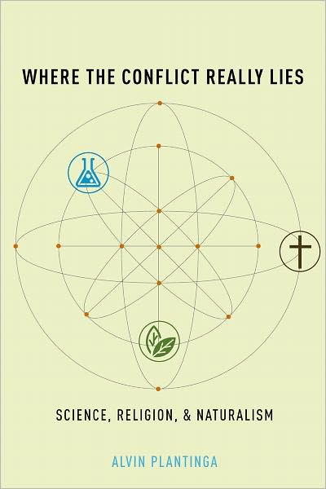
slido.com #4598726

Slide 5
‘It is theism, not naturalism, that deserves to be called “the scientific worldview”’ Alvin Plantinga
Why science works
Why the universe is as it is
Why humans can do science
How and why to do science
Why science works
Why the universe is as it is
Why humans can do science
How and why to do science
atheism
science
Christianity
slido.com #4598726

Slide 6
Science commissioned
Science as obedience
Genesis 1-2
How do these chapters show us the closeness of humanity’s relationship to the natural world?
slido.com #4598726

Slide 7
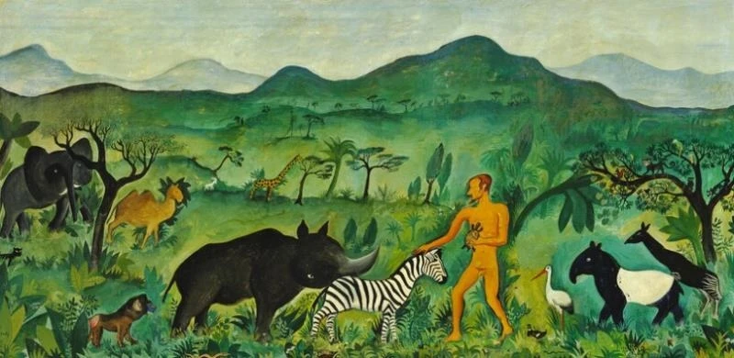
Science commissioned
Science as obedience
Genesis 1-2
‘Now the Lord God had formed out of the ground all the wild animals and all the birds in the sky. He brought them to the man to see what he would name them; and whatever the man called each living creature, that was its name.’
Genesis 2:19
Adam Names the Animals (1943), Hans Christian Scherfig
slido.com #4598726

Slide 8
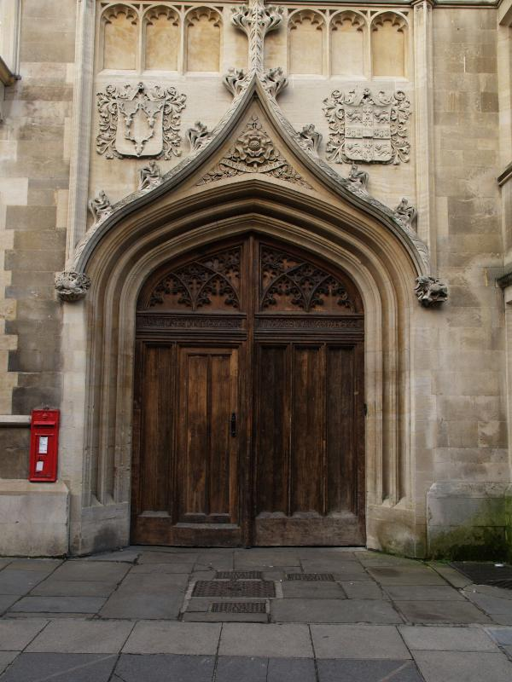
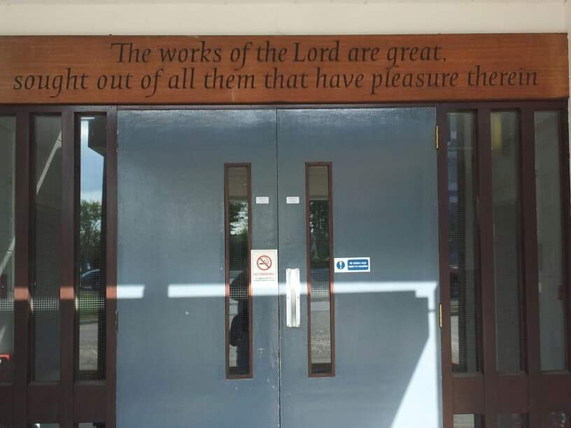
Science commissioned
Science as obedience
“Great are the works of the Lord;
they are pondered by all who delight in them.
Glorious and majestic are his deeds,
and his righteousness endures forever.”
Psalm 111:2-3
Science as worship
slido.com #4598726

Slide 9
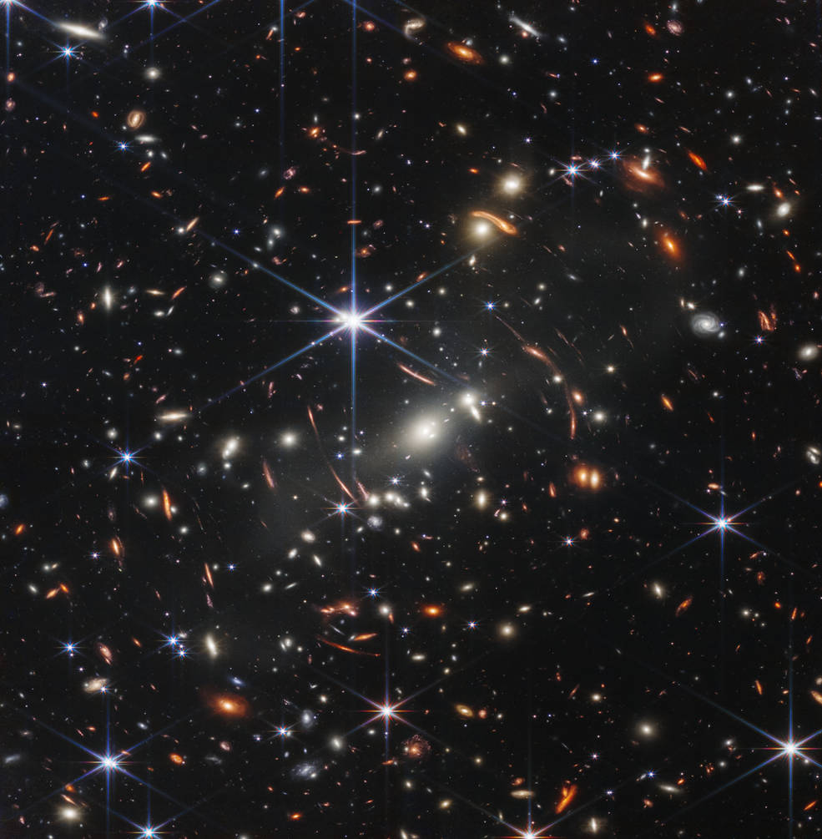
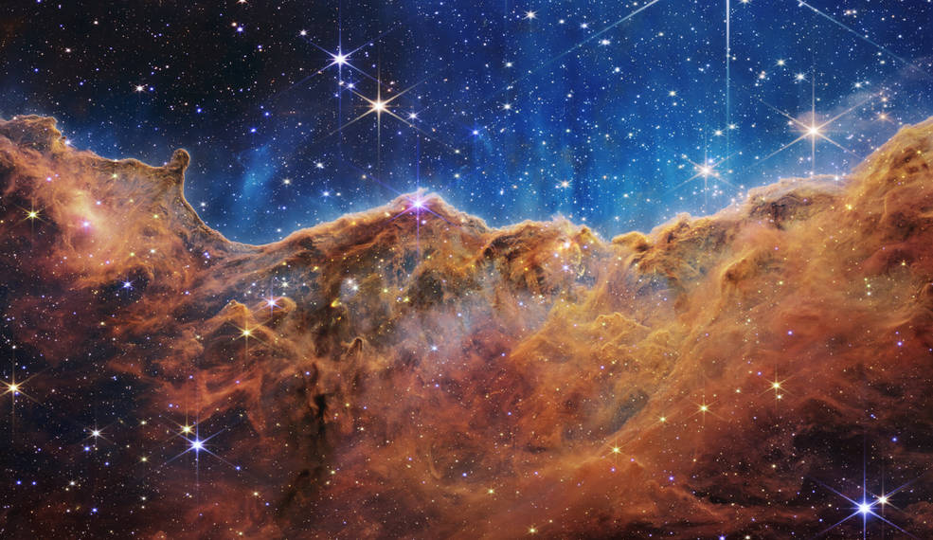
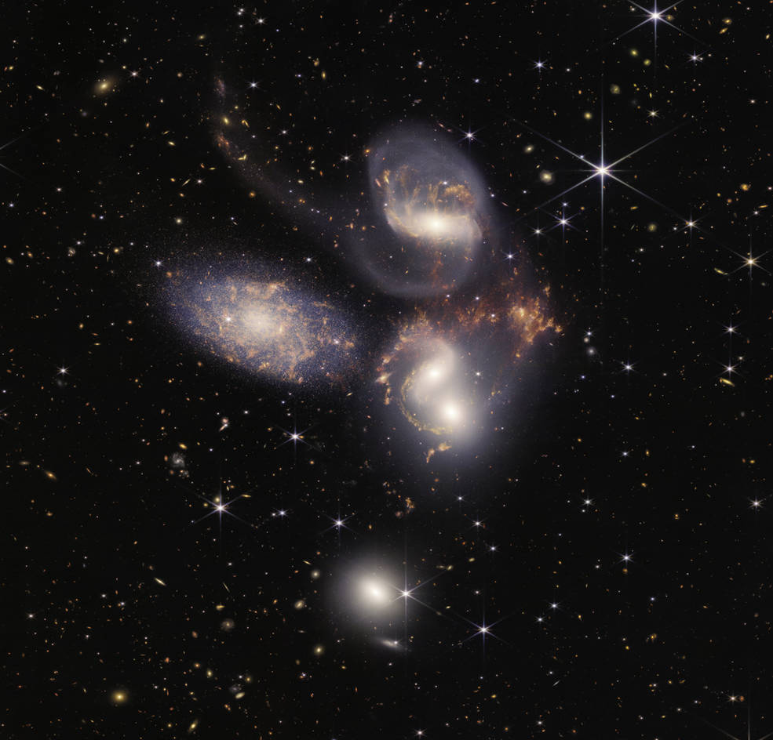
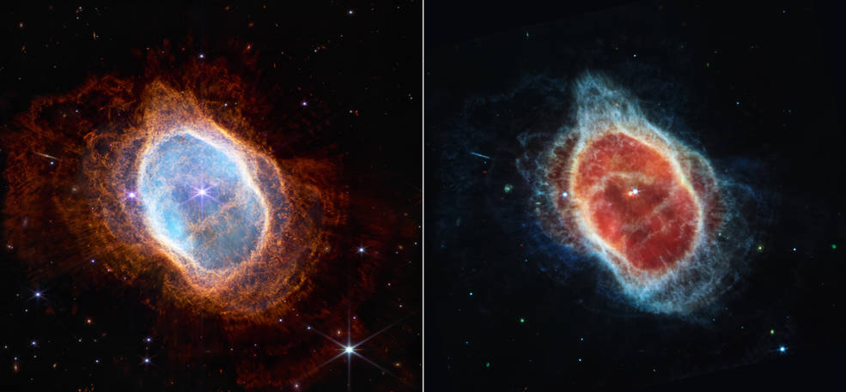

Slide 10
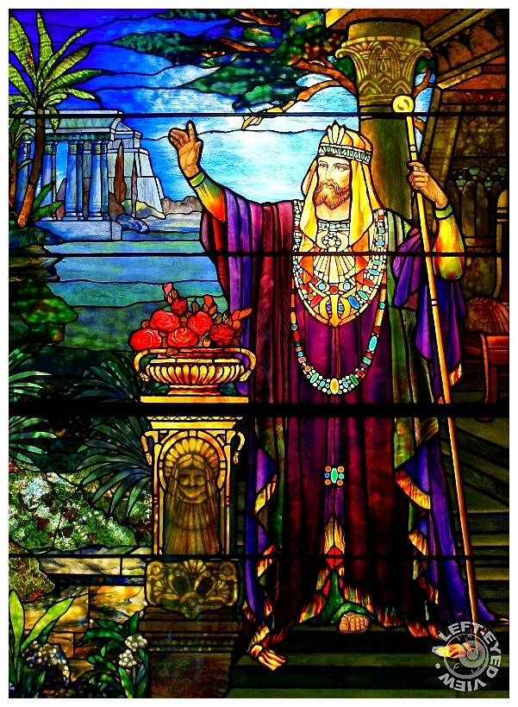
Science commissioned
Science as obedience
Science as worship
“[King Solomon] spoke about plant life, from the cedar of Lebanon to the hyssop that grows out of walls. He also spoke about animals and birds, reptiles and fish. From all nations people came to listen to Solomon’s wisdom, sent by all the kings of the world, who had heard of his wisdom.”
1 Kings 4:33-34
slido.com #4598726

Slide 11
Science commissioned
Science as obedience
Science as worship
‘Since God has left the fingerprints of his wisdom everywhere, since there is no place where God does not furnish us with raw materials for godly thinking, Christians should be seized with a rambunctious curiosity to ponder his works, both the majestic and the mundane. The task of wisdom is joyfully to describe and investigate all God’s works’.
Dale Ralph Davis, The Wisdom and the Folly
slido.com #4598726

Slide 12
Science fallen
Science as survival
Genesis 3
Humanity’s relationship with nature cursed
slido.com #4598726

Slide 13
Science fallen
Science as survival
Science as grace
Genesis 3
Humanity’s relationship with nature cursed
Genesis 4
“Lamech married two women, one named Adah and the other Zillah. Adah gave birth to Jabal; he was the father of those who live in tents and raise livestock. His brother’s name was Jubal; he was the father of all who play stringed instruments and pipes. Zillah also had a son, Tubal-Cain, who forged all kinds of tools out of bronze and iron.”
4:19-22
slido.com #4598726

Slide 14
Science redeemed
Science as reconciliation
All this is from God, who reconciled us to himself through Christ and gave us the ministry of reconciliation: that God was reconciling the world to himself in Christ.
2 Corinthians 5:18-19
For God was pleased to have all his fullness dwell in [Jesus], and through him to reconcile to himself all things, whether things on earth or things in heaven, by making peace through his blood, shed on the cross.
Colossians 1:19-20
slido.com #4598726

Slide 15
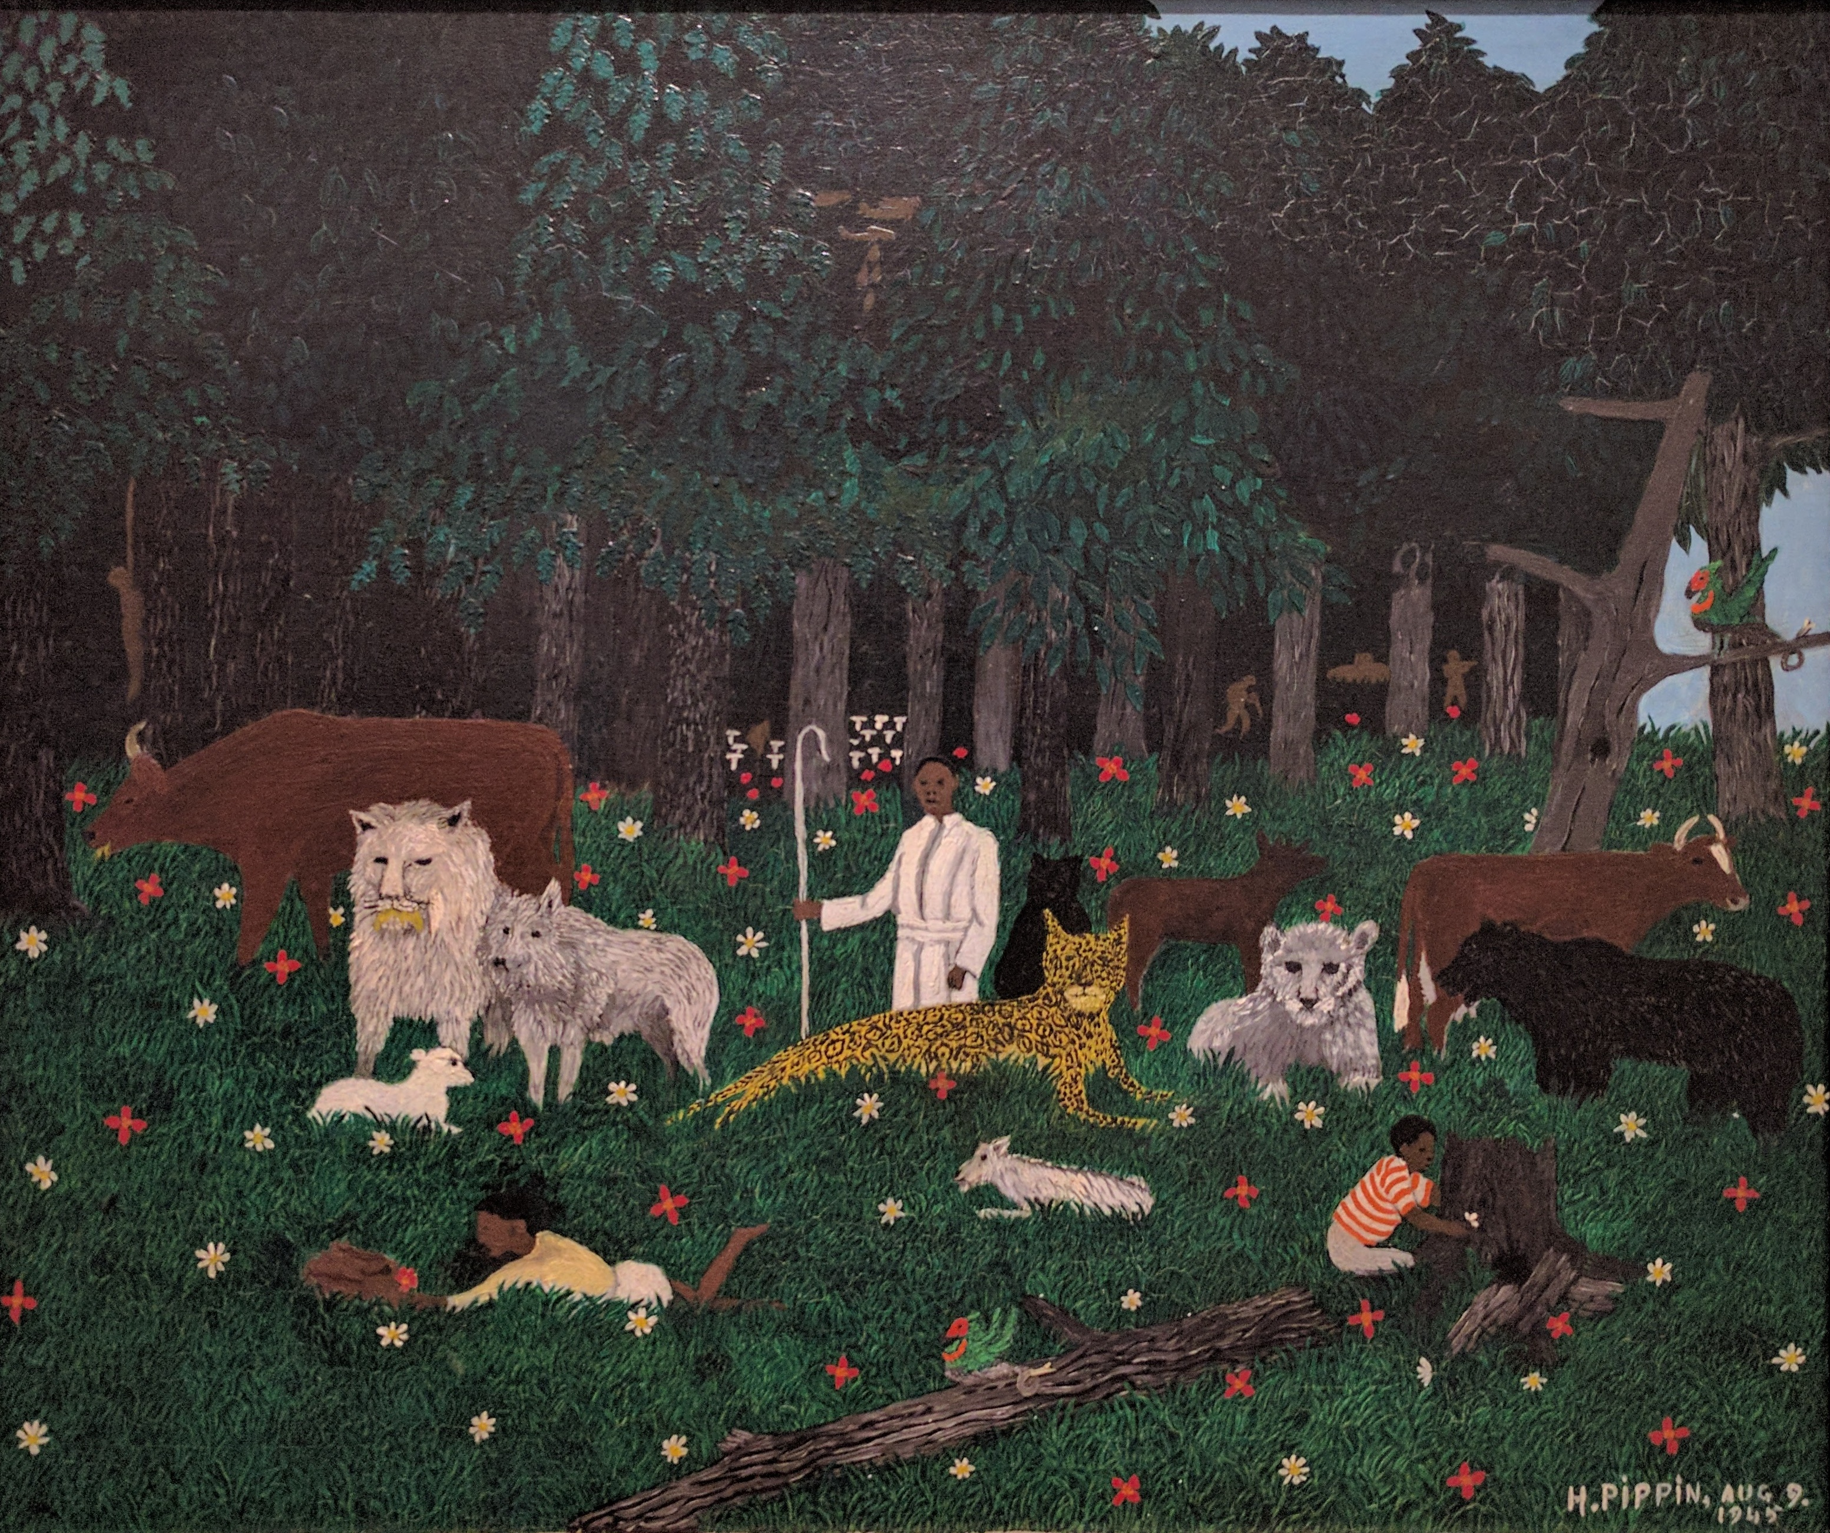
Science redeemed
Science as reconciliation
“The wolf will live with the lamb,
the leopard will lie down with the goat,
the calf and the lion and the yearling together;
and a little child will lead them.
The cow will feed with the bear,
their young will lie down together,
and the lion will eat straw like the ox.
The infant will play near the cobra’s den,
and the young child will put its hand into the viper’s nest.
They will neither harm nor destroy
on all my holy mountain,
for the earth will be filled with the knowledge of the Lord
as the waters cover the sea.”
Isaiah 11:6-9
Holy Mountain III (1945), Horace Pippin
slido.com #4598726

Slide 16
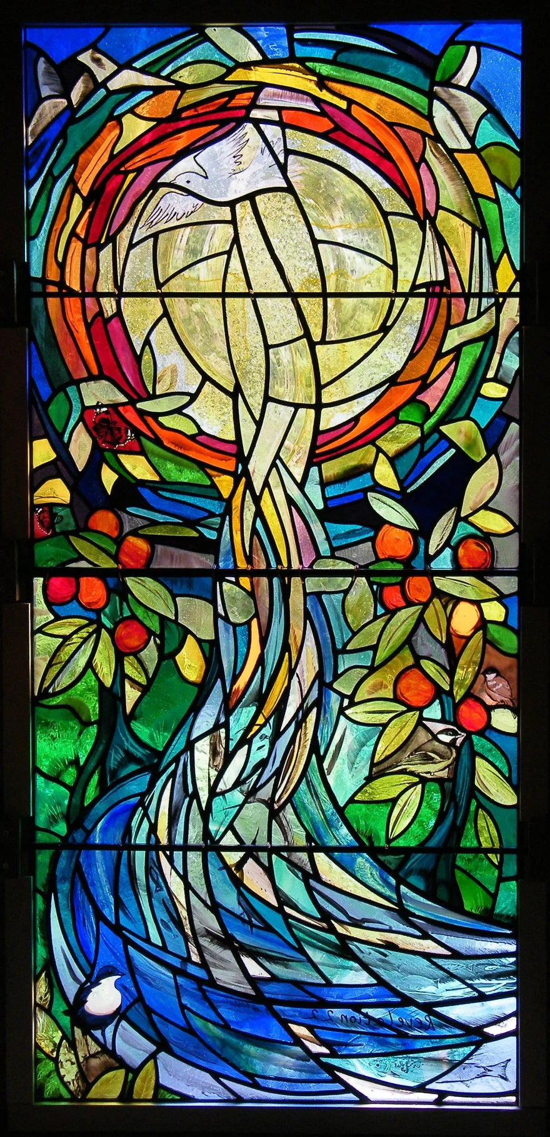
Science redeemed
Science as reconciliation
“On each side of the river stood the tree of life, bearing twelve crops of fruit, yielding its fruit every month. And the leaves of the tree are for the healing of the nations. No longer will there be any curse.” Revelation 22:2-3
Greenhope, Emma Butler-Cole Aiken
slido.com #4598726

Slide 17
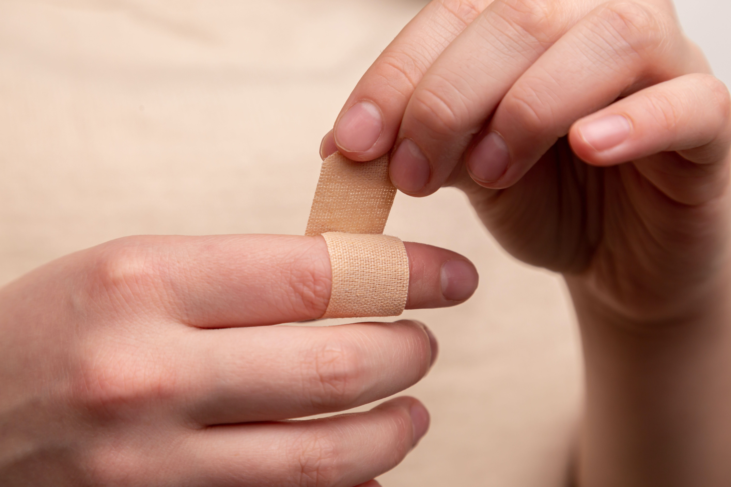
Science redeemed
Science as reconciliation
“On each side of the river stood the tree of life, bearing twelve crops of fruit, yielding its fruit every month. And the leaves of the tree are for the healing of the nations. No longer will there be any curse.” Revelation 22:2-3
Greenhope, Emma Butler-Cole Aiken
slido.com #4598726

Slide 18
Science as obedience
Science as worship
Science as survival
Science as grace
Science as reconciliation
Discuss: How does the Christian story about science compare with an atheist one?
slido.com #4598726

Slide 19
Christian story | Atheist story
Resonant with reality Relational Going somewhere | Inconsistent with reality For our own benefit only Ultimately futile
slido.com #4598726

Slide 20
Taking all this home…
Host a ‘meal with a message’ with your friends sharing some of what you heard this week
Grab a flyer on your way out and apply to join Sparked!
Meet with other scientists at your uni
Join us at Word Alive
Got questions we didn’t have time to answer? Send them to us via Instagram/Slido and we’ll answer on our stories!
See you next time!
slido.com #4598726

