Slide 1
Hasn’t science killed atheism?
Science Network Track
Welcome to the first Science Network seminar! While we’re waiting for everyone to arrive, why not chat with the person next to you about this question:
What kind of objections to Christianity do you hear from other scientists?
slido.com #4598726

Slide 2
atheism
science
Christianity
slido.com #4598726

Slide 4
atheism
science
Christianity
slido.com #4598726

Slide 5
Hasn’t science killed atheism?
Science Network Track
Welcome to the first Science Network seminar! While we’re waiting for everyone to arrive, why not chat with the person next to you about this question:
What kind of objections to Christianity do you hear from other scientists?
slido.com #4598726

Slide 6
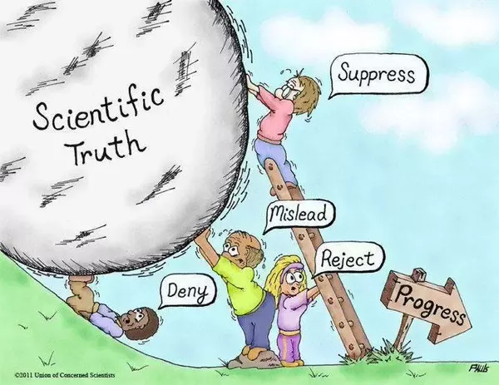
atheism
science
Christianity
slido.com #4598726

Slide 7
“French and Spanish. What about you?”
“Cosmologist - I’m a cosmologist.”
“What’s that?”
“A kind of religion for intelligent atheists.”
“Intelligent atheists?”
“You’re not religious, are you?”
slido.com #4598726

Slide 8
atheism
science
Christianity
slido.com #4598726

Slide 9
Four reasons why science is not in love with atheism
slido.com #4598726

Slide 10
Four reasons why science is not in love with atheism
1. Atheism can’t explain why science works
What needs to be true about the universe for science to work?
slido.com #4598726

Slide 11
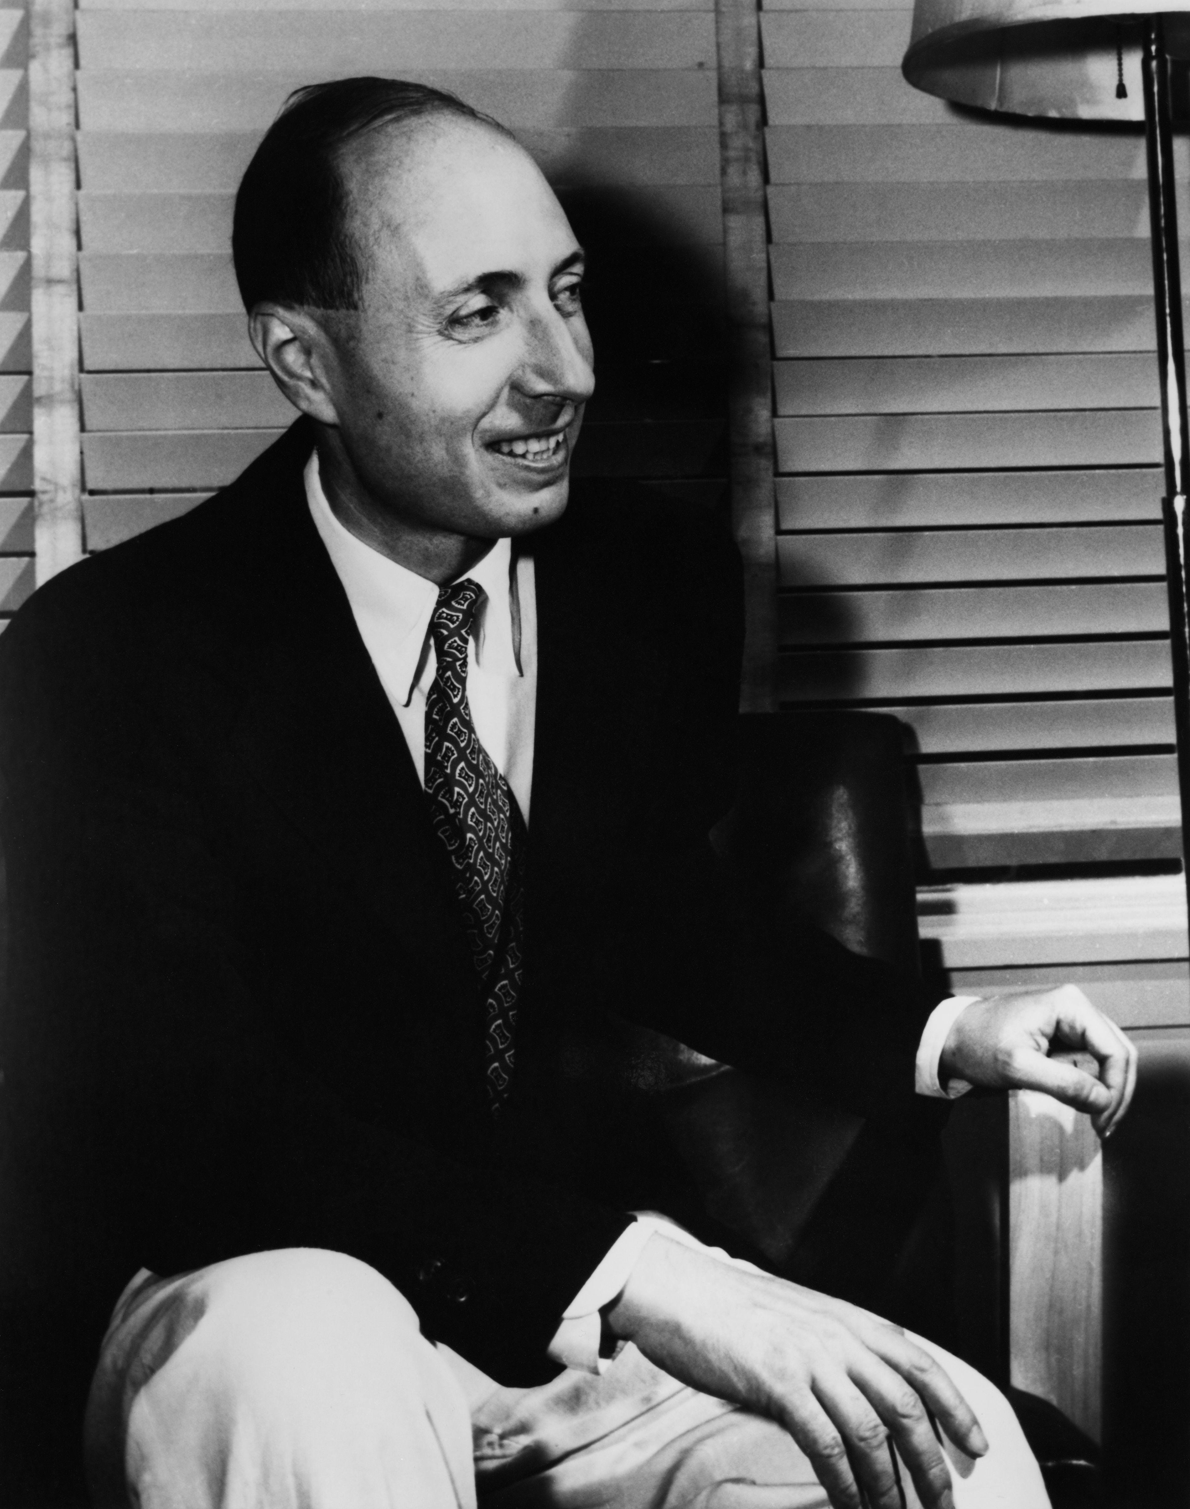
Four reasons why science is not in love with atheism
1. Atheism can’t explain why science works
‘The enormous usefulness of mathematics in the natural sciences is something bordering on the mysterious and there is no rational explanation for it’.
Eugene Wigner, The Unreasonable Effectiveness of Mathematics
slido.com #4598726

Slide 12
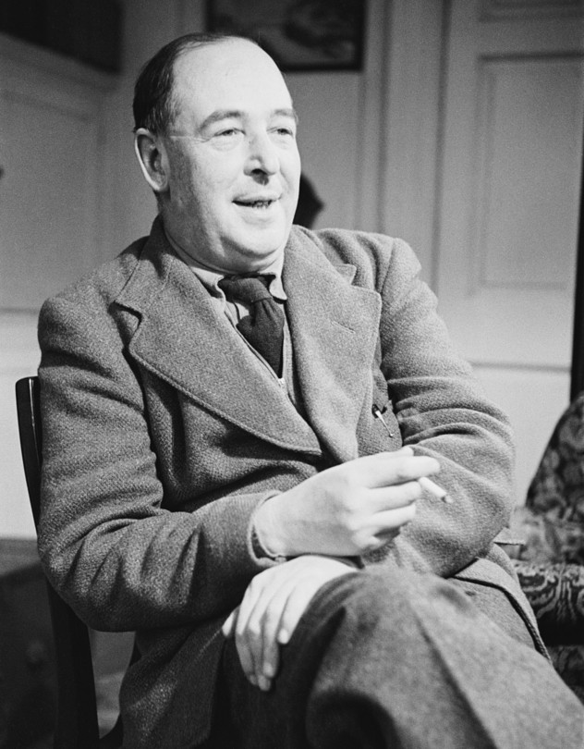
Four reasons why science is not in love with atheism
1. Atheism can’t explain why science works
‘The enormous usefulness of mathematics in the natural sciences is something bordering on the mysterious and there is no rational explanation for it’.
Eugene Wigner, The Unreasonable Effectiveness of Mathematics
‘They [did science] because they expected Law in Nature, and they expected Law in Nature because they believed in a Legislator.’ C.S. Lewis
slido.com #4598726

Slide 13
Four reasons why science is not in love with atheism
2. Atheism can’t explain the kind of world that science describes
slido.com #4598726

Slide 14
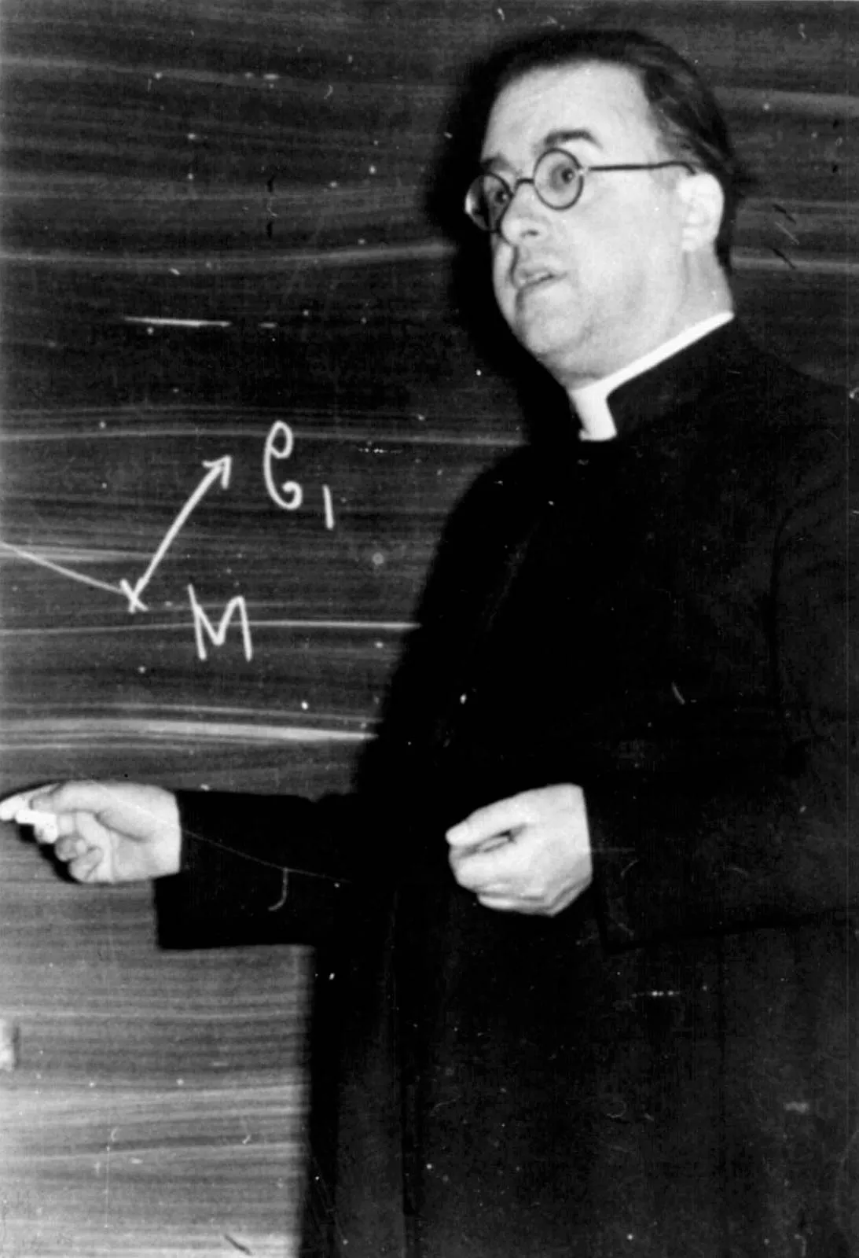
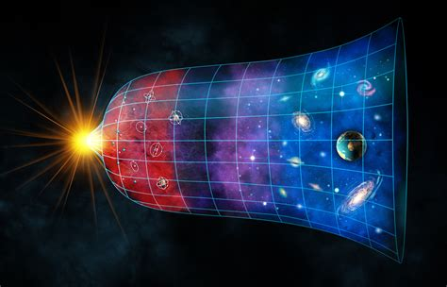
Four reasons why science is not in love with atheism
2. Atheism can’t explain the kind of world that science describes
Big Bang vs steady state Georges Lemaitre
slido.com #4598726

Slide 15
Four reasons why science is not in love with atheism
2. Atheism can’t explain the kind of world that science describes
Big Bang vs steady state Georges Lemaitre
‘Fine-tuning’ of physical constants
1000000000000
slido.com #4598726

Slide 16
Four reasons why science is not in love with atheism
2. Atheism can’t explain the kind of world that science describes
Big Bang vs steady state Georges Lemaitre
‘Fine-tuning’ of physical constants
‘If you faced a firing squad with fifty guns trained on you, you should not be surprised to find that you were alive after they had fired. After all, that is the only outcome you could possibly have observed.’
slido.com #4598726

Slide 17
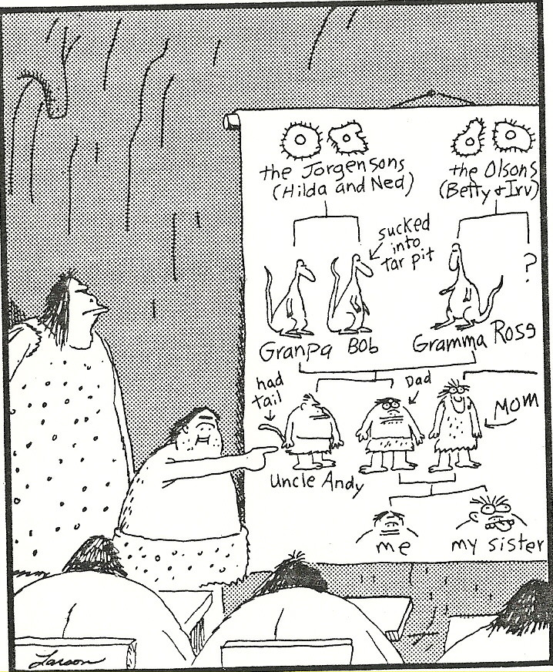
Four reasons why science is not in love with atheism
3. Atheism can’t explain why humans can do science
‘The evolutionary argument against naturalism’
Alvin Plantinga: Where the Conflict Really Lies
Do our cognitive faculties produce mostly true beliefs, or not?
Image of God vs random, unguided evolution
slido.com #4598726

Slide 18
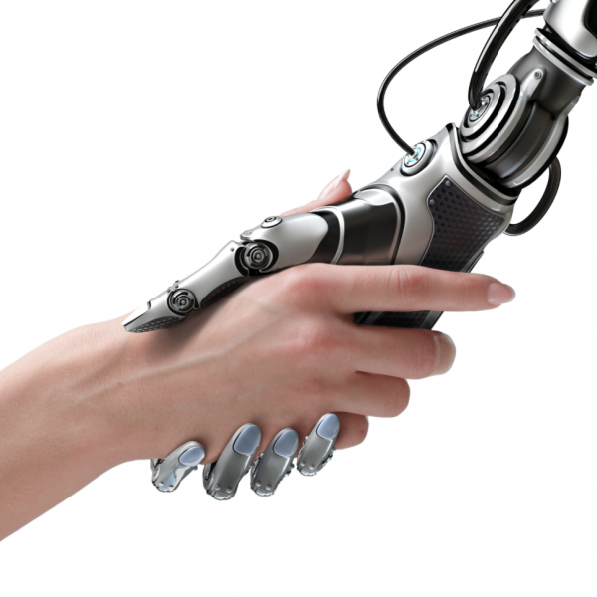
Four reasons why science is not in love with atheism
4. Atheism can’t tell us why or how to do science
How would a typical scientist answer this question: ‘Why is science worth doing?’
How things are ≠ how things should be
slido.com #4598726

Slide 19
‘It is theism, not naturalism, that deserves to be called “the scientific worldview”’ Alvin Plantinga
Why science works
Why the universe is as it is
Why humans can do science
How and why to do science
Why science works
Why the universe is as it is
Why humans can do science
How and why to do science
atheism
science
Christianity
slido.com #4598726

